Slide 1

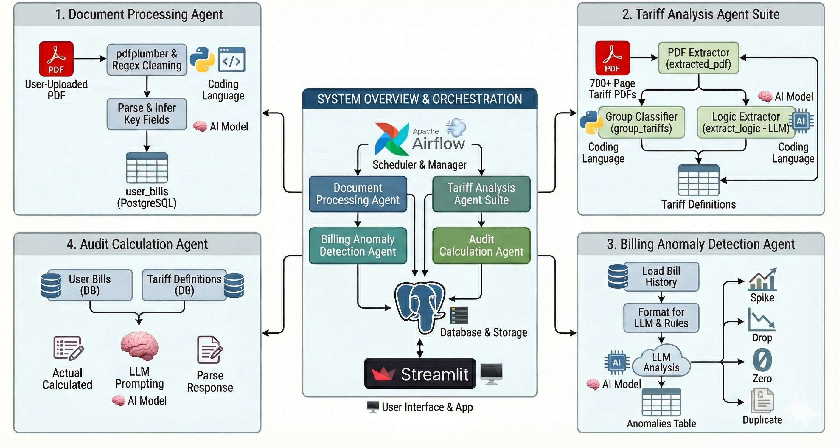
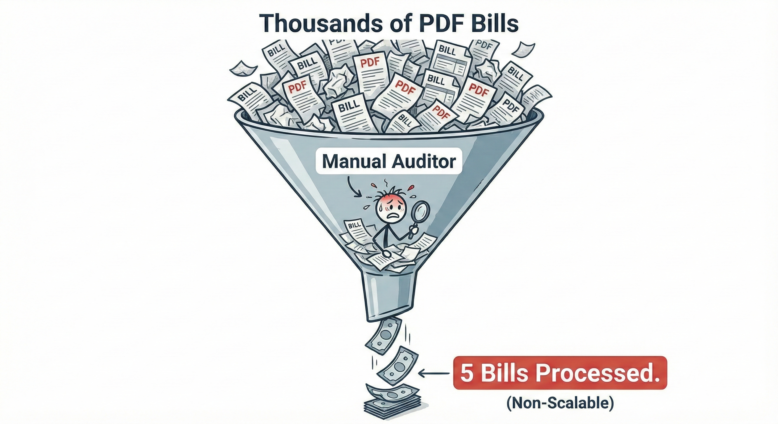
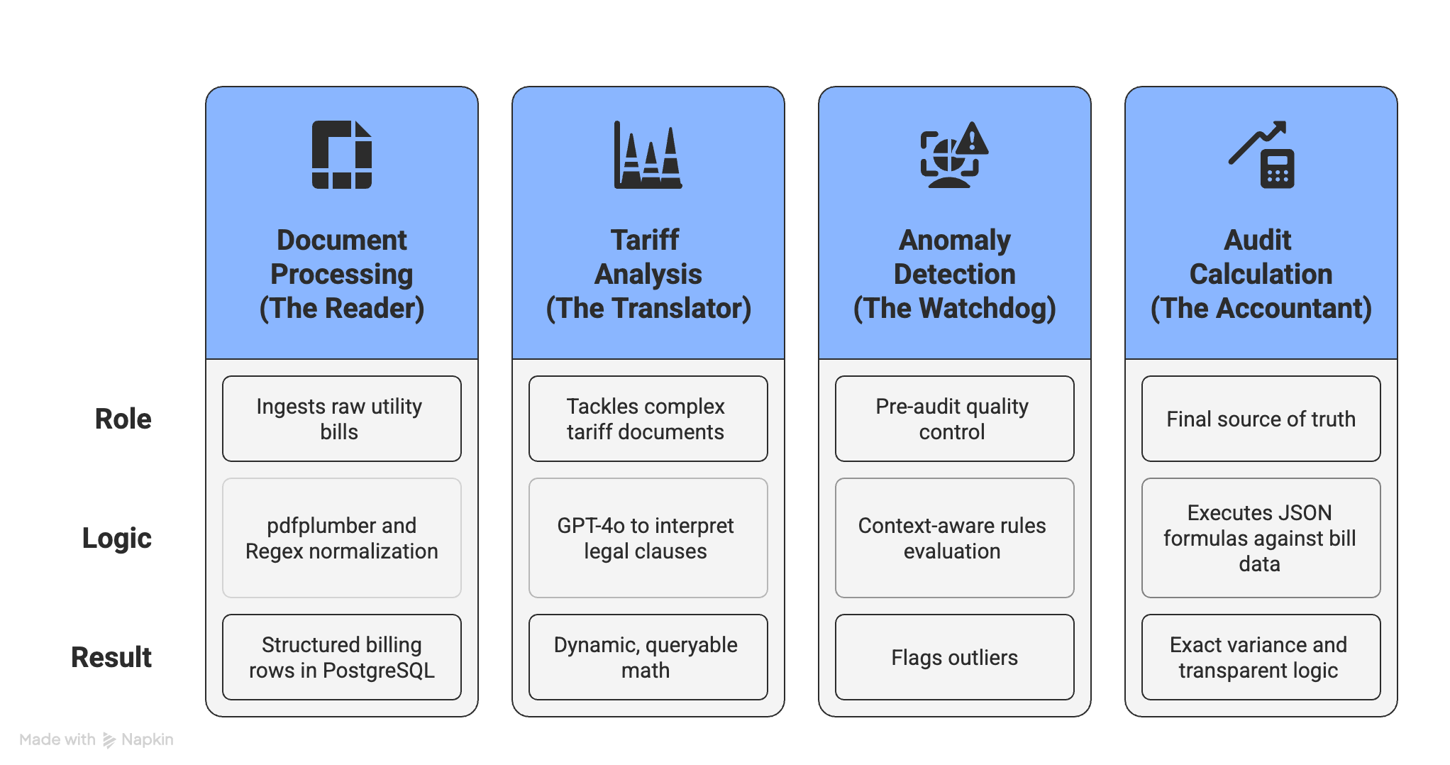
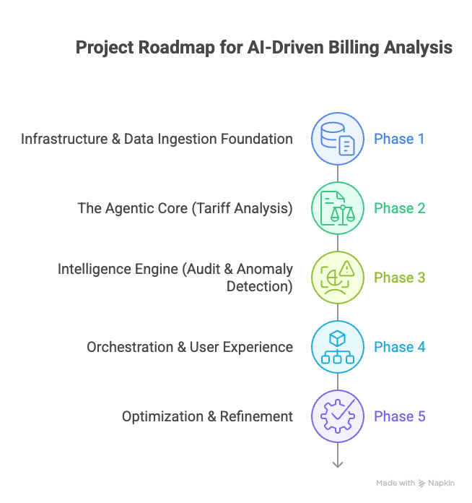
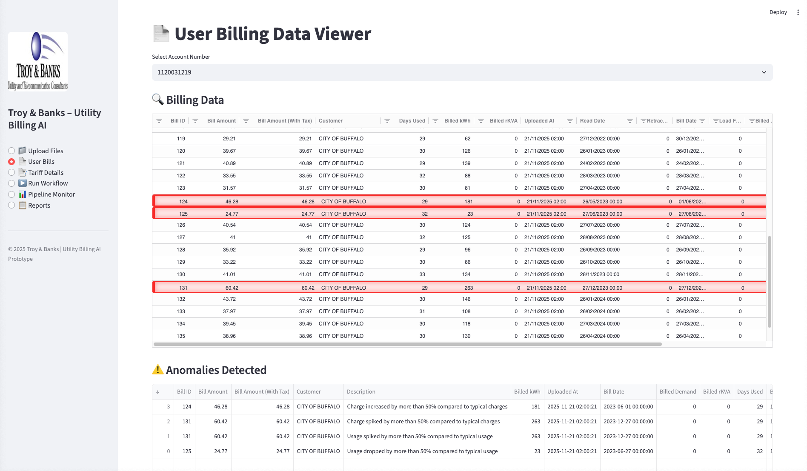
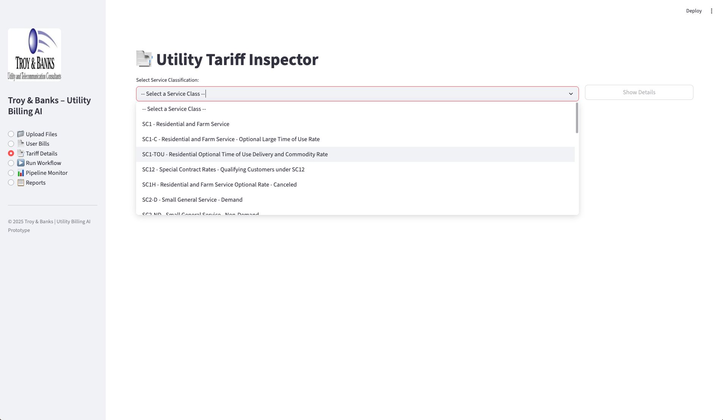
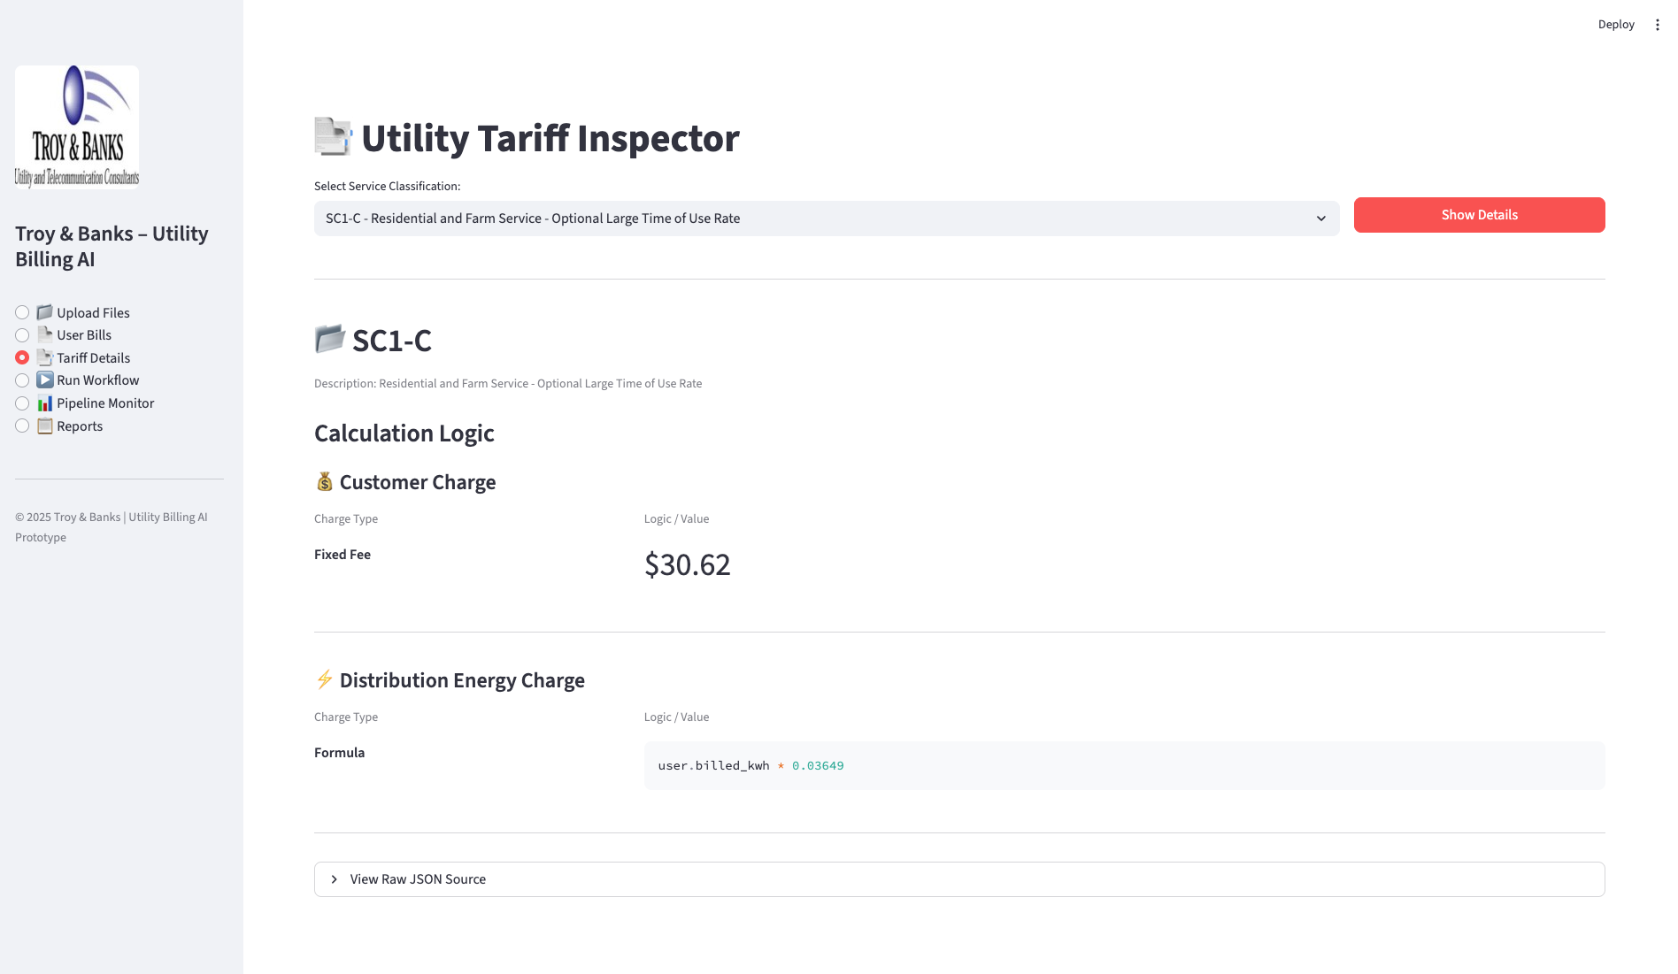
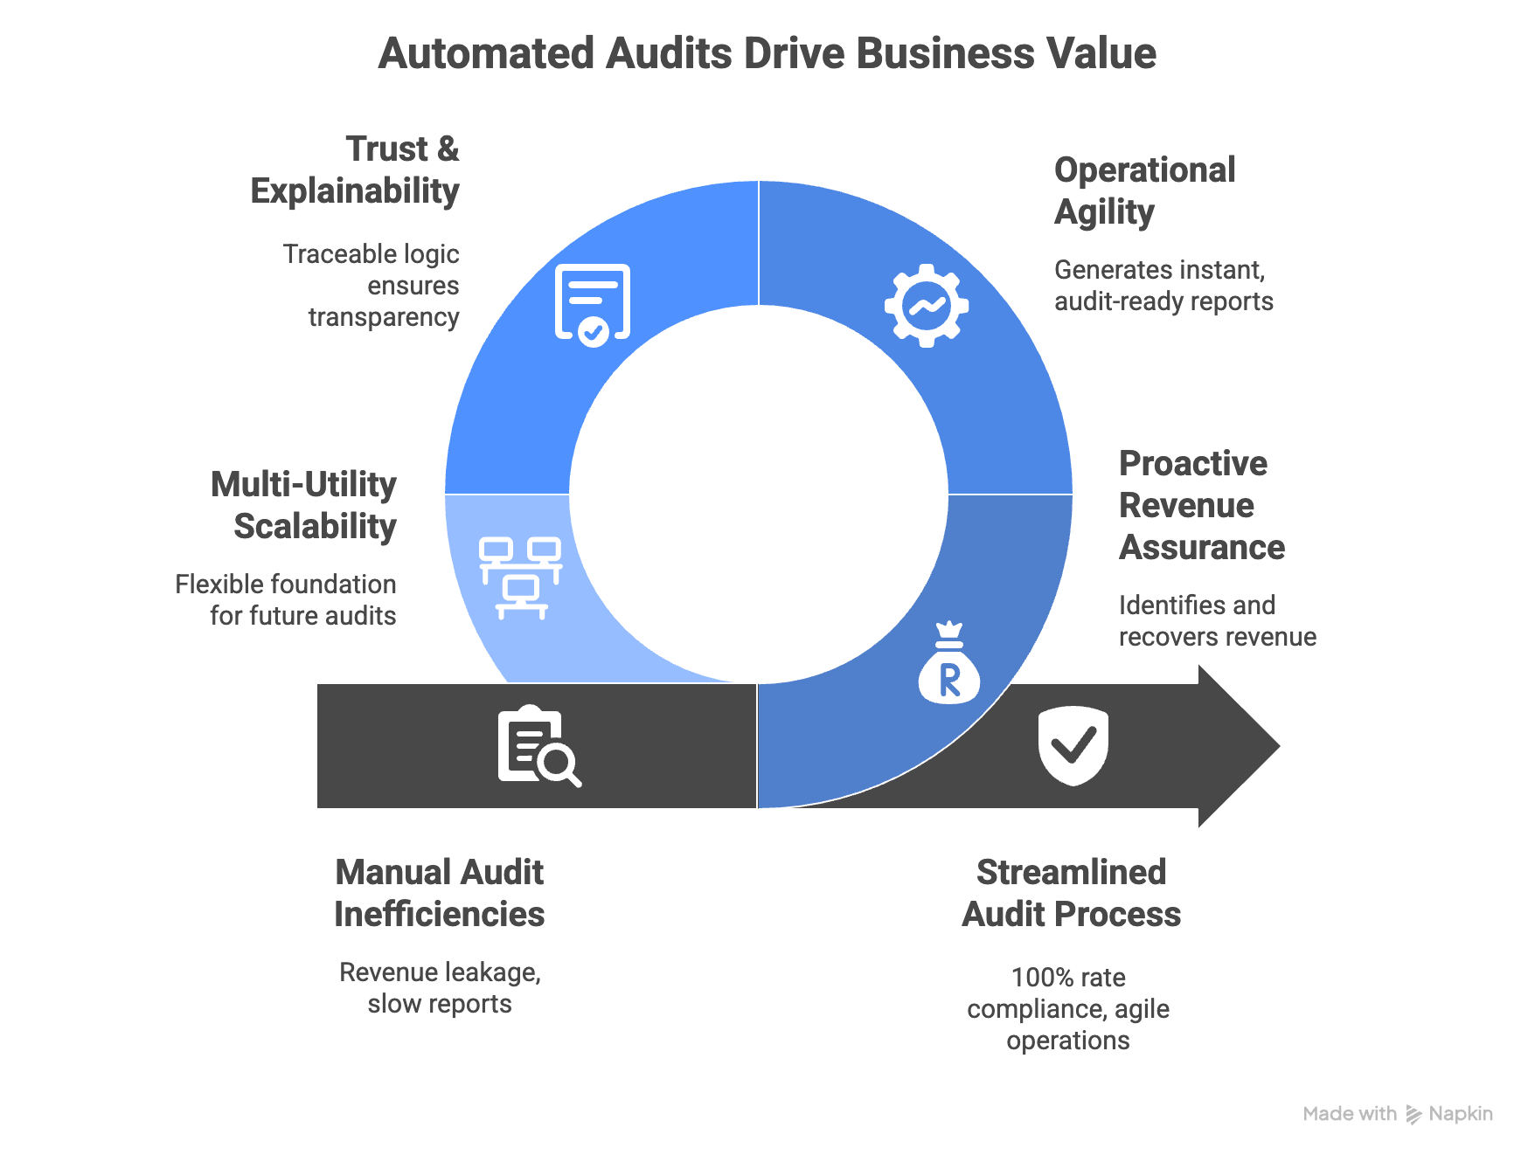
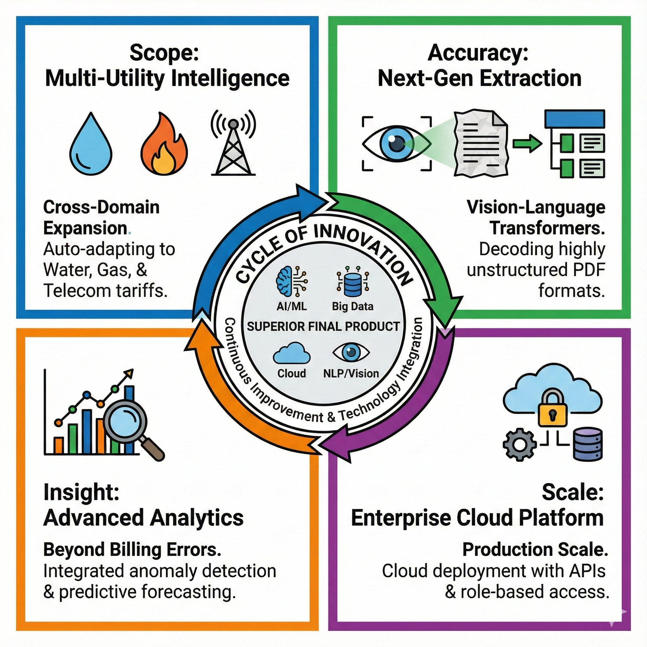












AI-Driven Utility Billing Automation: Scalable Auditing with Dynamic Tariff Engines
Transforming Manual Energy Auditing with Multi-Agent Systems and LLMs
Team : EagleEye
Harshal Patil, Avipsa Bhujabal, Aarushi Jugran
Mentors:
Prof. Adithya Narayanan, Prof. Saverio Marrazzo
THE CHALLENGE :
SYSTEM ARCHITECTURE:
OUR HYBRID APPROACH :
The Manual Bottleneck Utility auditing is a highly specialized, labor-intensive process that resists traditional automation due to data complexity.
Unscalable Workflow: Human experts require 2-4 hours to process a single complex municipal bill.
Capacity Cap: Operational limits restrict output to just 5-10 bills per day per auditor.
Data Heterogeneity:
Bills: Thousands of formats across different utility providers and service classes.
Tariffs: Pricing rules are buried in 700+ page PDF legal documents, making simple "regex" extraction impossible.
Rules + LLM Hybrid Model: Ensures both deterministic validation for accuracy and contextual reasoning for complex scenarios.
Dynamic Tariff Engine: Supports yearly changes and updates instantly without requiring code modification.
Explainable AI (XAI): Unlike "black box" systems, generates a transparent Logic Trace for every calculation, ensuring audits are legally defensible.
Instant Scalability: Decouples logic extraction from calculation, allowing the system to process thousands of accounts instantly.
Context-Aware Anomaly Detection: Automatically flags billing deviations and complex issues like Load Factor swings or sudden usage drops accompanied by cost spikes.
AGENTIC PIPELINE :
PROJECT ROADMAP :
The Input & Translation
The Validation & Audit
1
2
3
4
DASHBOARDS :
Automated anomaly detection with transparent bill visualization and audit-ready insights.
Multi-class tariff explorer with complete support for residential, commercial, and special-contract rates.
Real-time tariff breakdown—turning complex rate structures into simple, explainable logic.
BUSINESS IMPACT :
CONCLUSION :
FUTURE ENHANCEMENTS :
Revenue Assurance: Proactively identifies revenue leakage and ensures 100% rate compliance, recovering costs that manual audits miss.
Operational Agility: Dramatically reduces audit time by eliminating manual tariff lookups and generates audit-ready reports instantly, freeing analysts for high-value strategy.
Trust & Explainability: "Glass-box" architecture provides traceable logic for every calculation, ensuring outputs are defensible and transparent.
Multi-Utility Scalability: Establishes a flexible foundation ready to scale beyond electric into gas, water, and telecom audits.
Modernization: Replaced manual review with AI extraction and dynamic rule engines.
Scalability: Delivers immediate accuracy and dramatic time savings.
Strategic Value: Transforms the client from a reactive manual auditor into a proactive, data-driven financial consultancy.
TECH STACK :
. . . . .
Institute for Artificial Intelligence and Data Science
School of Engineering and Applied Science
Acknowledgements
Justin Raybeck, Energy Auditor/Advisor; Troy & Banks, Inc.
Kevin Gibbs, Vice President of Strategic Partnerships; Troy & Banks, Inc.

Slide 2
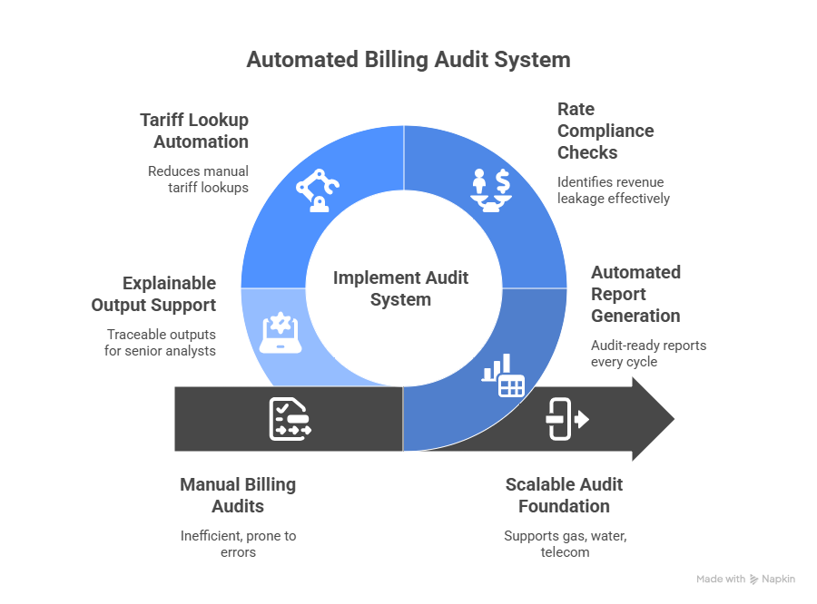
AI-Driven Utility Billing Automation: Scalable Auditing with Dynamic Tariff Engines
Transforming Manual Energy Auditing with Multi-Agent Systems and LLMs
Team : EagleEye
Harshal Patil, Avipsa Bhujabal, Aarushi Jugran
Mentors:
Prof. Adithya Narayanan, Prof. Saverio Marrazzo
THE CHALLENGE :
SYSTEM ARCHITECTURE:
OUR HYBRID APPROACH :
The Manual Bottleneck Utility auditing is a highly specialized, labor-intensive process that resists traditional automation due to data complexity.
Unscalable Workflow: Human experts require 2-4 hours to process a single complex municipal bill.
Capacity Cap: Operational limits restrict output to just 5-10 bills per day per auditor.
Data Heterogeneity:
Bills: Thousands of formats across different utility providers and service classes.
Tariffs: Pricing rules are buried in 700+ page PDF legal documents, making simple "regex" extraction impossible.
Rules + LLM Hybrid Model: Ensures both deterministic validation for accuracy and contextual reasoning for complex scenarios.
Dynamic Tariff Engine: Supports yearly changes and updates instantly without requiring code modification.
Explainable AI (XAI): Unlike "black box" systems, generates a transparent Logic Trace for every calculation, ensuring audits are legally defensible.
Instant Scalability: Decouples logic extraction from calculation, allowing the system to process thousands of accounts instantly.
Context-Aware Anomaly Detection: Automatically flags billing deviations and complex issues like Load Factor swings or sudden usage drops accompanied by cost spikes.
THE AGENTIC PIPELINE (METHODOLOGY). :
The Input & Translation
The Validation & Audit
PROJECT ROADMAP
1. Document Processing ("The Reader")
Role: Ingests raw, messy utility bills.
Tech: Uses pdfplumber and Regex normalization to handle artifacts.
Output: Converts heterogeneous PDF layouts into structured, standardized billing rows in PostgreSQL.
2. Tariff Analysis ("The Translator")
Role: Tackles complex 700+ page Tariff Documents.
Innovation: Uses GPT-4o to interpret legal clauses and convert them into executable JSON Formula Trees.
Impact: Turns static legal text into dynamic, queryable math-decoupling logic from code.
3. Anomaly Detection ("The Watchdog")
Role: Pre-audit Quality Control.
Logic: Evaluates context-aware rules (e.g., "Did usage drop while cost increased?") to flag data errors before the audit begins.
Result: Flags outliers like Load Factor swings or duplicate charges.
4. Audit Calculation ("The Accountant")
Role: The Final Source of Truth.
Process: Executes the JSON Formulas (from Step 2) against the Bill Data (from Step 1).
Result: Calculates exact variance and generates a transparent Logic Trace for every dollar audited.
DASHBOARDS
Automated anomaly detection with transparent bill visualization and audit-ready insights.
Multi-class tariff explorer with complete support for residential, commercial, and special-contract rates.
Real-time tariff breakdown—turning complex rate structures into simple, explainable logic.
BUSINESS IMPACT
CONCLUSION
FUTURE ENHANCEMENTS
This platform dramatically reduces manual audit time, increases billing accuracy, and ensures consistent tariff compliance across all utilities and service classes. By automatically detecting anomalies and recalculating charges, it helps the client to identify over-billing, recover potential savings, and deliver faster, data-backed insights to clients. Centralized storage, automated workflows, and clear visual reporting streamline analyst operations, enabling the firm to scale audits efficiently and serve more clients with higher precision.
This project demonstrates how AI, rule engines, and automated data pipelines can modernize traditional utility bill auditing. By creating a robust extraction pipeline, dynamic tariff engine, and advanced anomaly-detection framework, we deliver a scalable and accurate solution that enhances the client's review workflow and reduces processing time dramatically.
TECH STACK :
. . . . .
Institute for Artificial Intelligence and Data Science
School of Engineering and Applied Science
Acknowledgements
Justin Raybeck, Energy Auditor/Advisor; Troy & Banks, Inc.
Kevin Gibbs, Vice President of Strategic Partnerships; Troy & Banks, Inc.

Slide 3
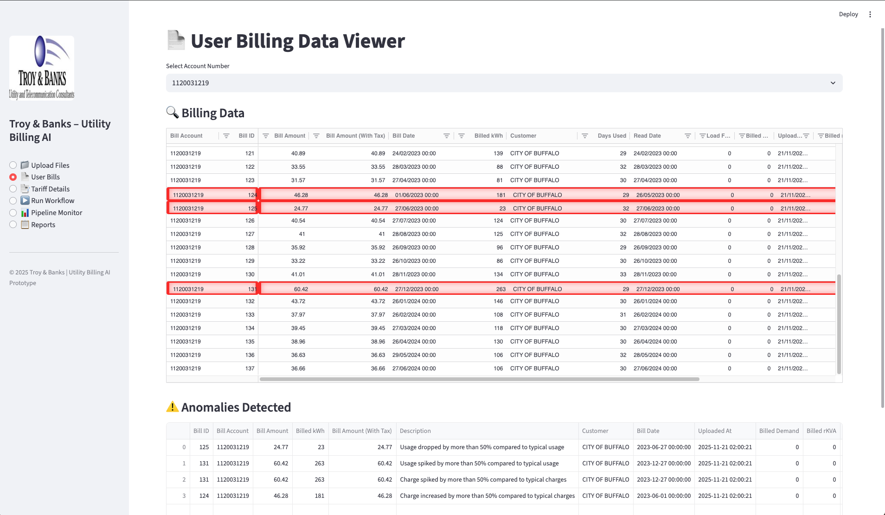
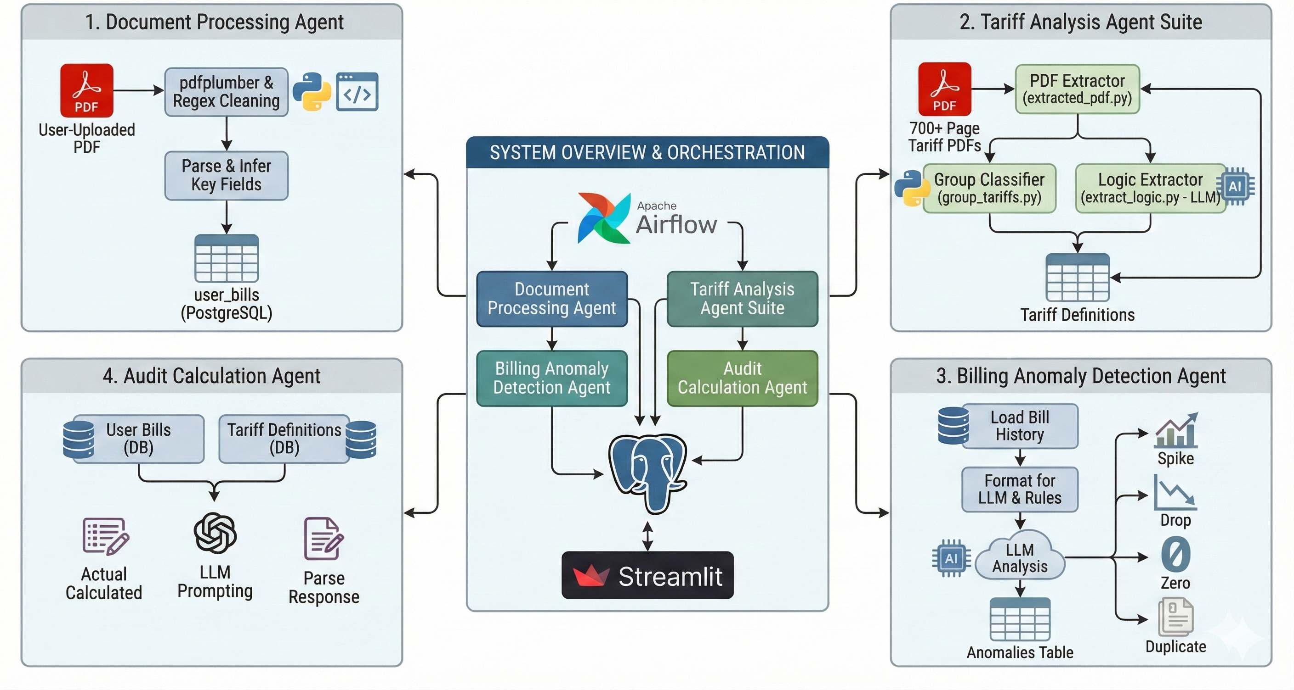
AI-Driven Utility Billing Automation: Scalable Auditing with Dynamic Tariff Engines
Transforming Manual Energy Auditing with Multi-Agent Systems and LLMs
Harshal Patil, Avipsa Bhujabal, Aarushi Jugran
THE CHALLENGE:
The Manual Bottleneck Utility auditing is a highly specialized, labor-intensive process that resists traditional automation due to data complexity.
Unscalable Workflow: Human experts require 2-4 hours to process a single complex municipal bill.
Capacity Cap: Operational limits restrict output to just 5-10 bills per day per auditor.
Data Heterogeneity:
Bills: Thousands of formats across different utility providers and service classes.
Tariffs: Pricing rules are buried in 700+ page PDF legal documents, making simple "regex" extraction impossible.
System Architecture & Methodology
AUTOMATED ANOMALY DETECTION The system acts as an intelligent "Watchdog" before human review.
Instant Visibility: The dashboard automatically flags specific billing cycles (highlighted in red) where actual charges deviate from expected tariff logic.
Context-Aware: Unlike simple threshold alerts, the system detects complex issues like Load Factor swings or usage drops accompanied by cost spikes.
Traceable Logic: Auditors can click any flag to view a transparent "Logic Trace," proving exactly why a bill was flagged (e.g., "Expected Energy Charge $44.45 vs. Actual $63.45").
The Input & Translation
1. Document Processing ("The Reader")
Role: Ingests raw, messy utility bills.
Tech: Uses pdfplumber and Regex normalization to handle artifacts.
Output: Converts heterogeneous PDF layouts into structured, standardized billing rows in PostgreSQL.
2. Tariff Analysis ("The Translator")
Role: Tackles complex 700+ page Tariff Documents.
Innovation: Uses GPT-4o to interpret legal clauses and convert them into executable JSON Formula Trees.
Impact: Turns static legal text into dynamic, queryable math—decoupling logic from code.
THE INNOVATION:
"Self-Driving" Audits We moved beyond rigid Python scripts to an Agentic AI Workflow. Instead of hard-coding rules, we built autonomous agents that "read" and "reason" like human experts.
From Code to Logic: We treat Tariff Rules as data, not code. The system uses LLMs to extract logic from legal PDFs into mathematical models.
Explainable AI (XAI): Unlike "black box" AI, our system generates a Logic Trace for every calculation, ensuring audits are transparent and legally defensible.
Scalability: The architecture decouples extraction from calculation, allowing the system to scale to thousands of accounts instantly.
The Validation & Audit
BUSINESS IMPACT
100x Scalability: Shifted from manual processing of 5-10 bills/day to handling thousands of accounts in a single batch run.
Speed: Reduced audit time per bill from 2-4 hours to seconds.
Accuracy: Eliminated human calculation errors by utilizing a deterministic Rule Engine rather than manual spreadsheet math.
Adaptability: New utility providers can be onboarded simply by uploading their Tariff PDF—the Agents "learn" the new rates without code rewrites.
3. Anomaly Detection ("The Watchdog")
Role: Pre-audit Quality Control.
Logic: Evaluates context-aware rules (e.g., "Did usage drop while cost increased?") to flag data errors before the audit begins.
Result: Flags outliers like Load Factor swings or duplicate charges.
4. Audit Calculation ("The Accountant")
Role: The Final Source of Truth.
Process: Executes the JSON Formulas (from Step 2) against the Bill Data (from Step 1).
Result: Calculates exact variance and generates a transparent Logic Trace for every dollar audited
TECHNOLOGY STACK

Slide 4
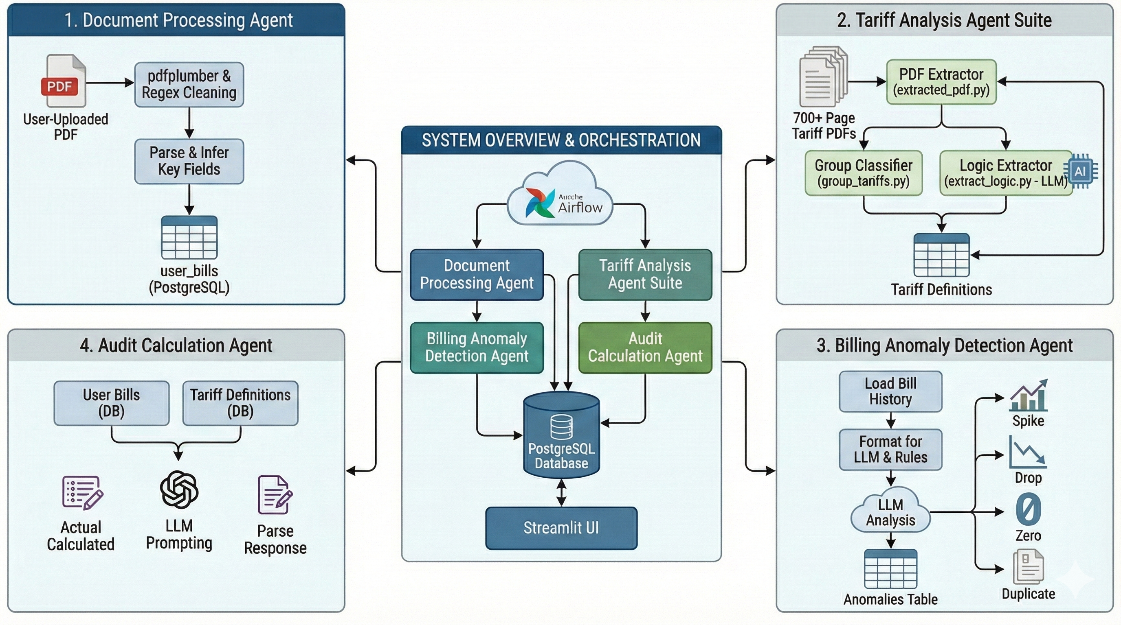
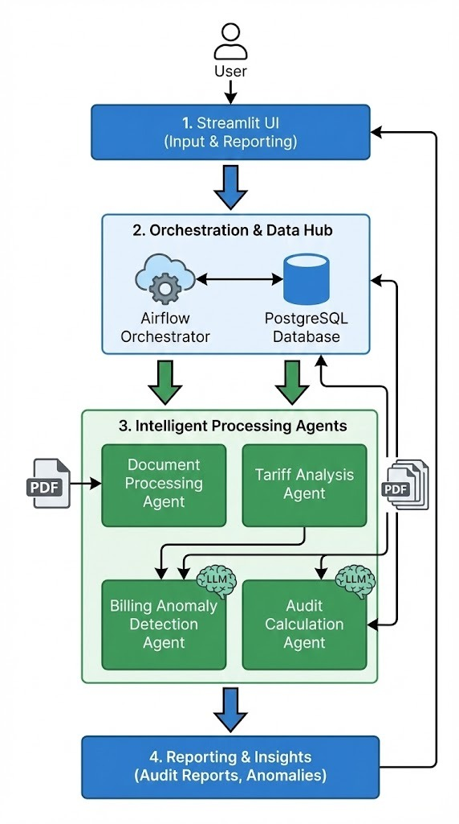

Slide 6
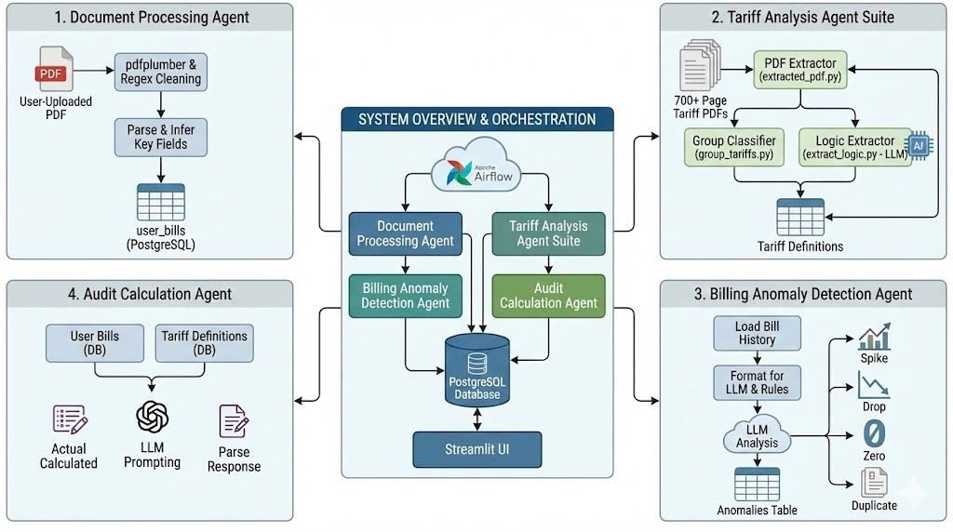
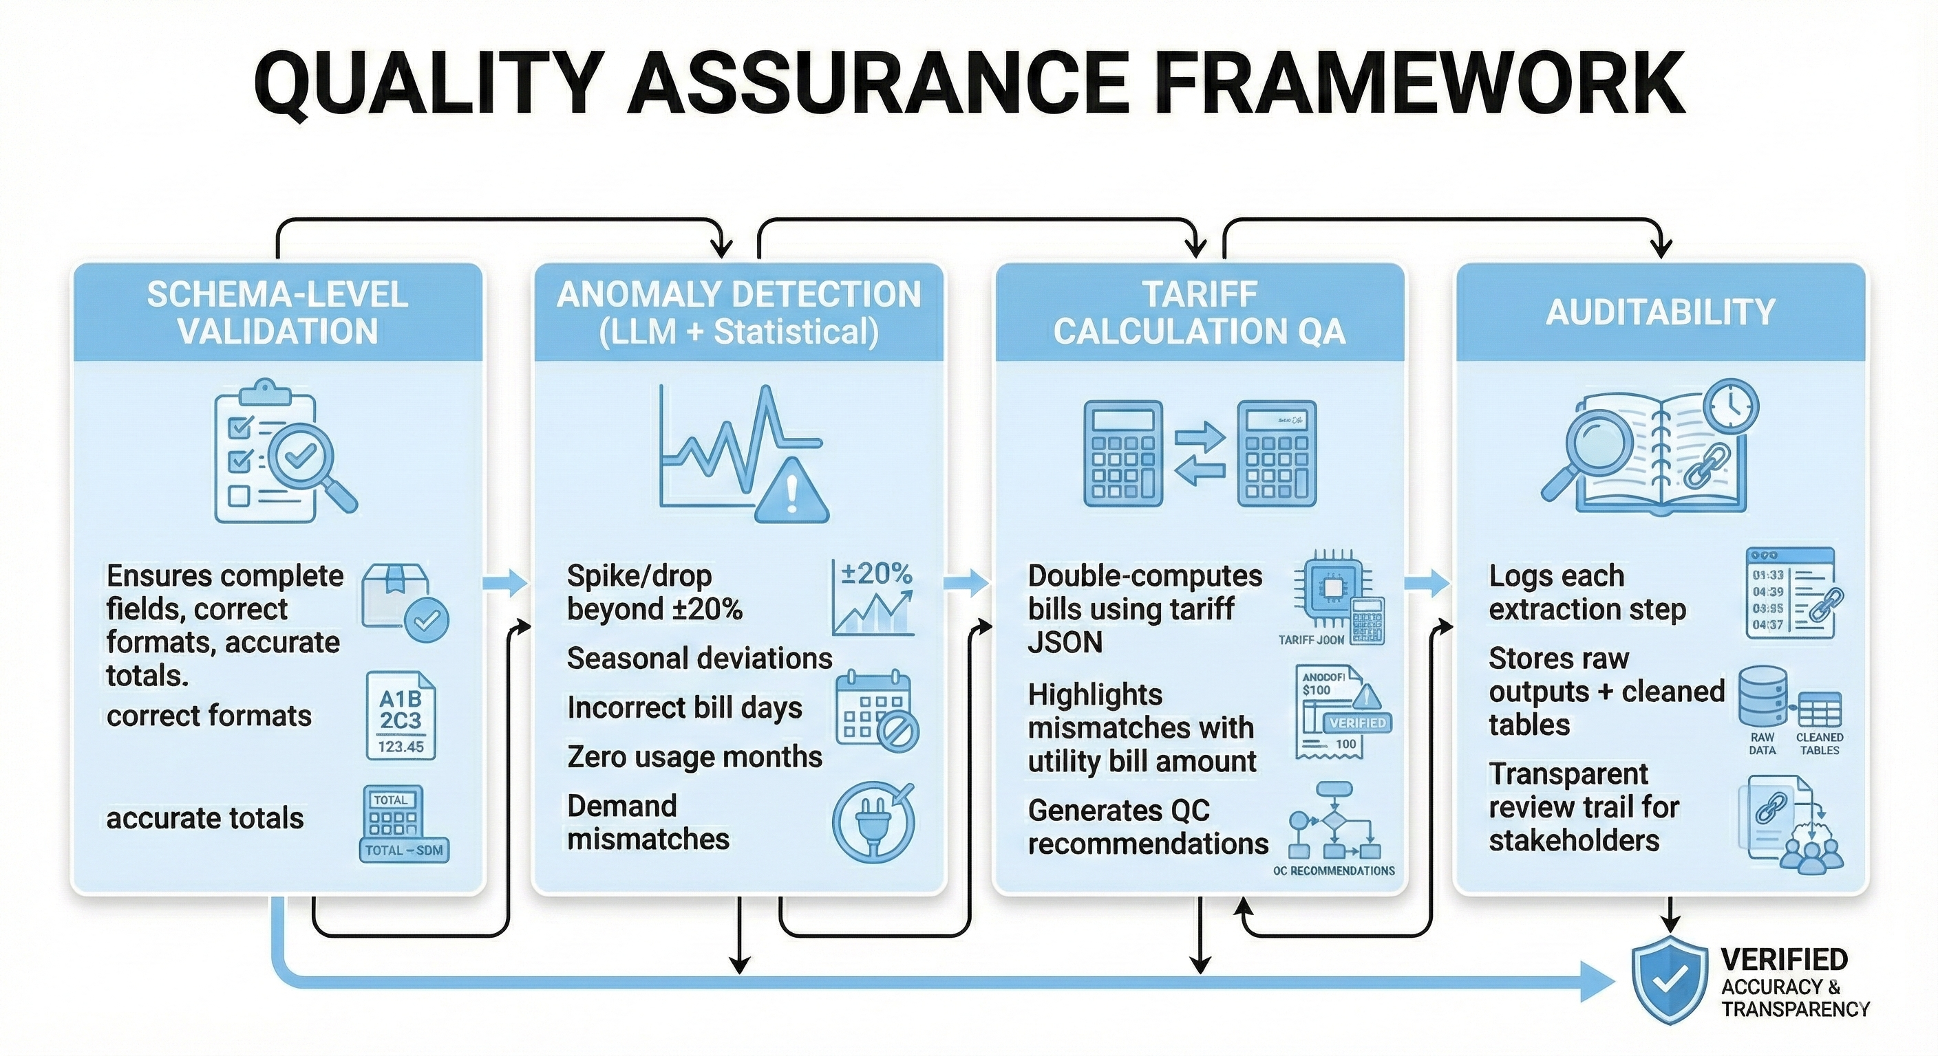
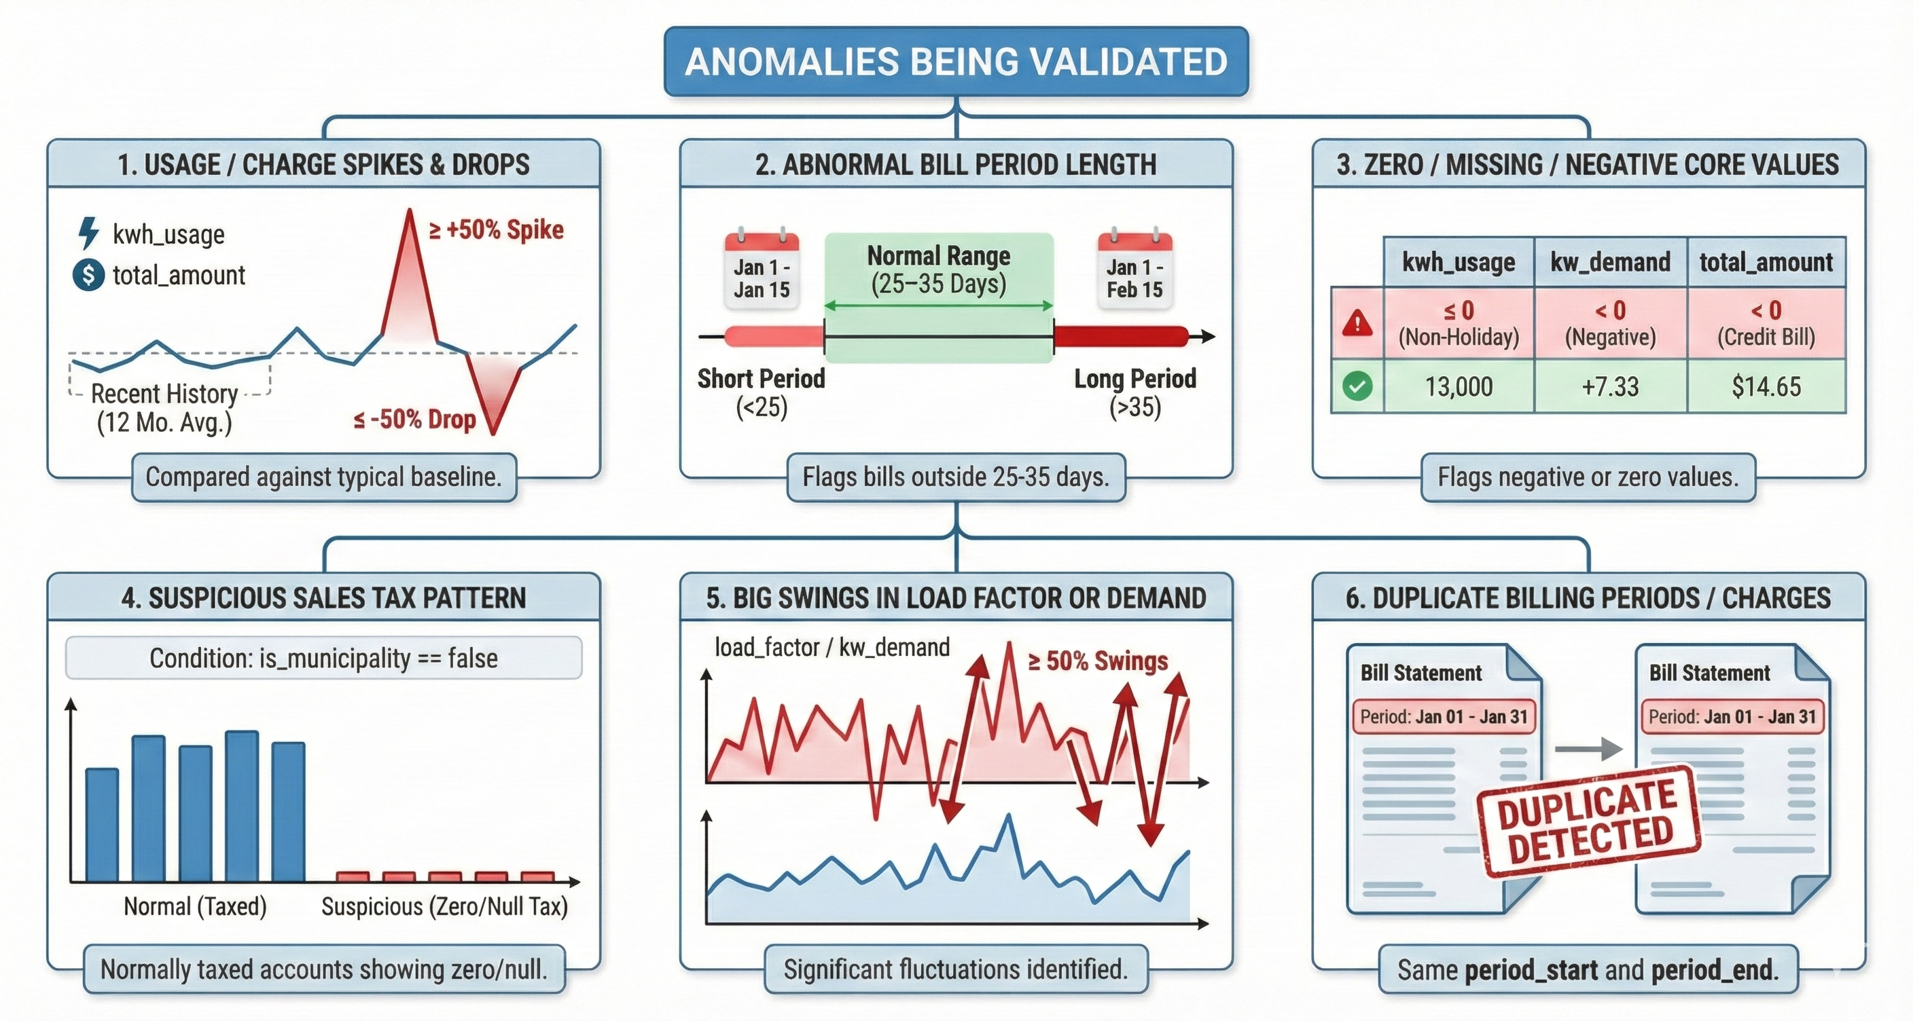
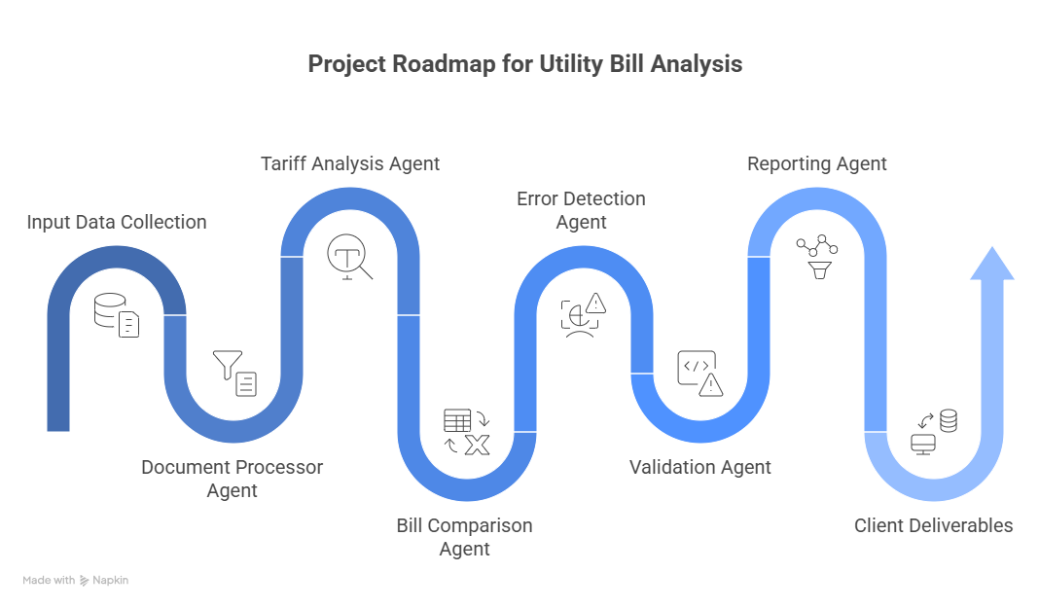
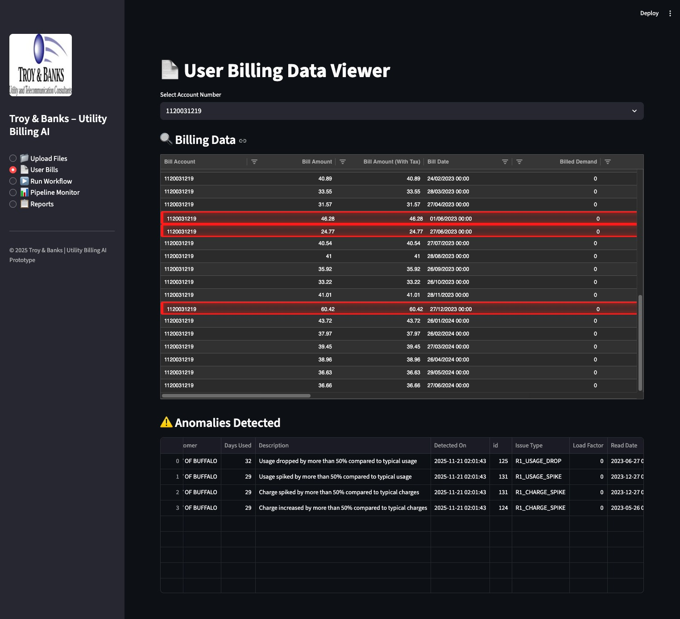
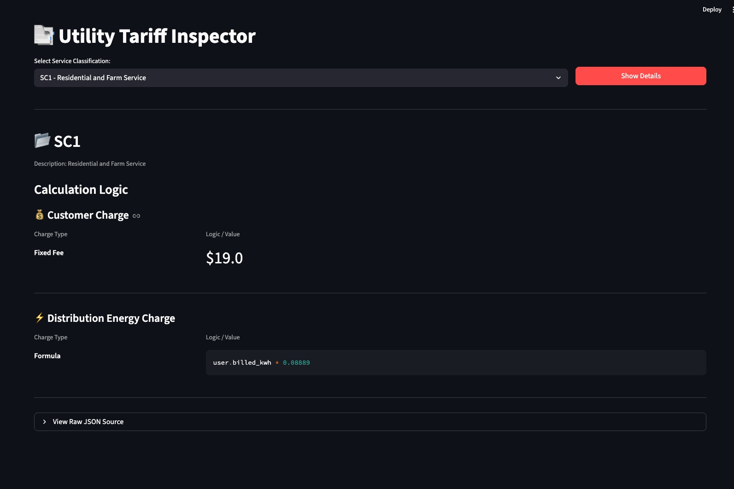
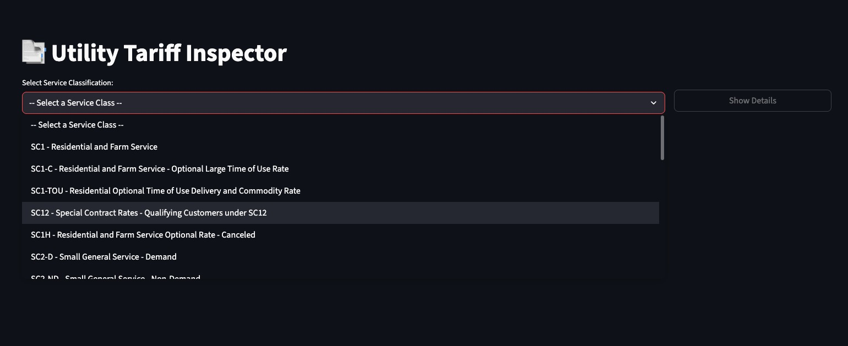
Utility Billing Automation
An AI-driven pipeline for high-accuracy utility bill extraction, validation and insights
Team: EagleEye
Harshal Patil, Avipsa Bhujabal, Aarushi Jugran
Problem Statement
Proposed Solution
Manual bill review faces three key challenges:
High Effort & Complexity: Bills arrive in varied formats (scanned PDFs, tables, multi-page statements) requiring manual extraction and verification.
Tariff Volatility: Service class tariffs (SC1, SC1C, SC2, SC3, SC3A…) change yearly, demanding constant updates to calculation models.
Undetected Anomalies: Usage spikes, incorrect demand charges, and mis-classified service classes often go unnoticed due to volume.
Troy & Banks needed a scalable, automated, auditable solution to accelerate their monthly billing review pipeline.
Why this approach?
Rules + LLM Hybrid Model: Ensures both deterministic validation and contextual reasoning.
Dynamic Tariff Engine: Supports yearly updates without changing code.
Client-Agnostic Pipeline: Works across 4 different client schemas.
Automated KPI Engine: Tracks spikes, trends, waste, inefficiencies.
AI Time-Series Forecasting: Predicts next-month bills, seasonal peaks, and anomalies.
Project Roadmap
Results
Multi-class tariff explorer with complete support for residential, commercial, and special-contract rates.
Automated anomaly detection with transparent bill visualization and audit-ready insights.
Real-time tariff breakdown—turning complex rate structures into simple, explainable logic.
Business Impact
Conclusion
Future Enhancements
This platform dramatically reduces manual audit time, increases billing accuracy, and ensures consistent tariff compliance across all utilities and service classes. By automatically detecting anomalies and recalculating charges, it helps Troy & Banks identify over-billing, recover potential savings, and deliver faster, data-backed insights to clients. Centralized storage, automated workflows, and clear visual reporting streamline analyst operations, enabling the firm to scale audits efficiently and serve more clients with higher precision.
This project demonstrates how AI, rule engines, and automated data pipelines can modernize traditional utility bill auditing. By creating a robust extraction pipeline, dynamic tariff engine, and advanced anomaly-detection framework, we deliver a scalable and accurate solution that enhances Troy & Banks’ review workflow and reduces processing time dramatically.
Expand tariff engine to support multiple utilities nationwide
Add forecasting models for consumption & demand
Add anomaly clustering to identify municipality-level patterns
Institute for Artificial Intelligence and Data Science
School of Engineering and Applied Science
Acknowledgements
Justin Raybeck, Energy Auditor/Advisor; Troy & Banks, Inc.
Kevin Gibbs, Vice President of Strategic Partnerships; Troy & Banks, Inc.
Saverio Marrazzo, Adithya Narayanan; Managing Partners

Slide 7
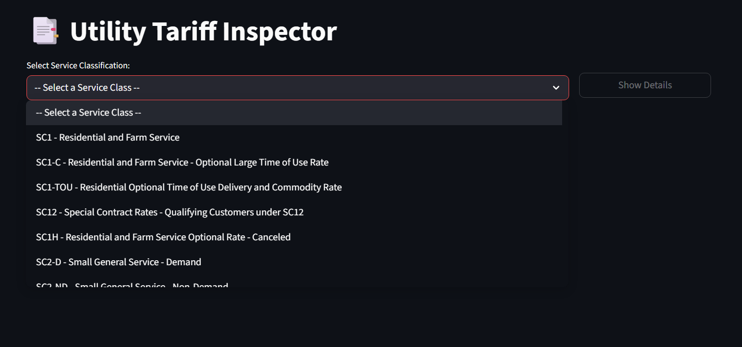
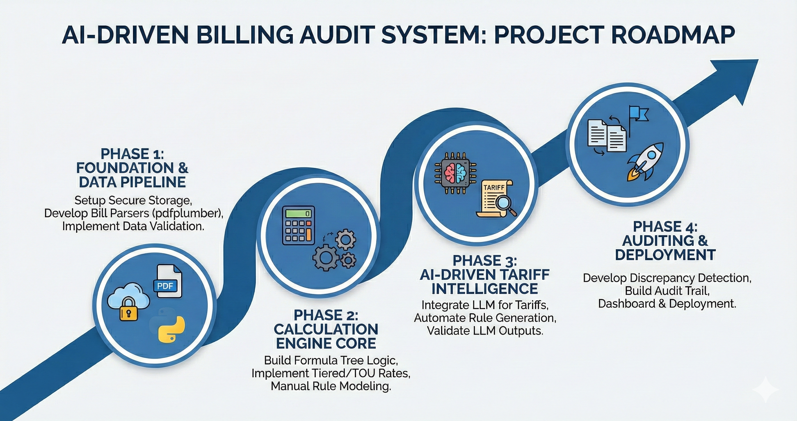
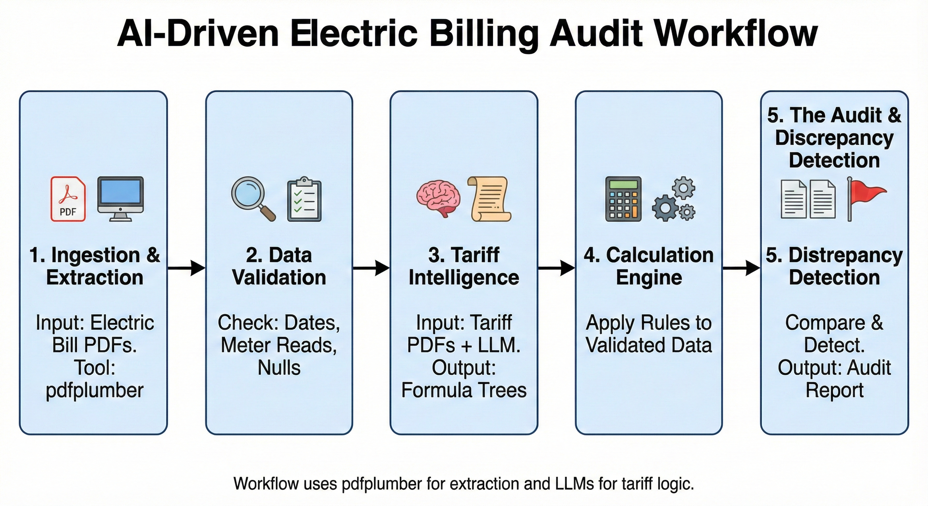
ELECTRIC BILL AUDIT AUTOMATION
Avipsa Bhujabal, Aarushi Jugran, Harshal Patil
Prof. Adithya Narayanan, Prof. Saverio Marrazzo
PROBLEM STATEMENT
Organizations that manage large numbers of utility accounts face frequent billing errors due to complex tariff structures, inconsistent bill formats, and manual verification processes. Monthly bills arrive as unstructured PDFs, requiring manual data entry and manual cross-checking against hundreds of pages of tariff rules. This slow and error-prone workflow leads to overcharges, financial losses, compliance issues, and makes large-scale auditing nearly impossible. There is an urgent need for an automated, scalable system capable of interpreting tariff logic, validating charges, and detecting discrepancies accurately and efficiently.
PROJECT ROADMAP
RESULT
The following diagram shows the four-phase roadmap followed for developing the fully automated utility bill auditing system. It starts from the foundational data engineering work to the advanced AI-driven tariff intelligence and final deployment of the project.
Phase 1: Foundation & Data Pipeline
This phase establishes the technical groundwork and involves building robust PDF bill parsers using pdfplumber, designing the ingestion pipeline, and implementing data validation rules to ensure inputs are clean, consistent, and reliable for downstream calculations.
Phase 2: Calculation Engine Core
The focus now turns to building the core billing calculation engine. This component reconstructs utility bills by handling complex pricing structures such as tiered rates, seasonal variations, and time-of-use pricing. The engine is the computational backbone of the auditing system.
Phase 3: AI-driven Tariff Intelligence
It also incorporates an LLM-based module that automatically interprets tariff documents and extracts structured rules. These rules involve customer charges, energy rates, demand charges, surcharges, and conditional provisions that are validated and transformed into executable formula trees utilized in the calculation engine.
Phase 4: Auditing & Deployment
These components are integrated into a comprehensive discrepancy detection system. The model detects overcharging, misapplied rates, and incorrect calculations using transparent audit trails. The final solution is deployed as an interactive dashboard that enables users to perform high-accuracy bill audits at large scales using automation.
PROPOSED SOLUTION
An AI-driven billing audit system is being developed with the intent to eliminate manual verification of complex utility bills in their entirety. The billing audit system will automatically verify that the invoice received from a utility company is accurate according to all rules and regulations. An AI will convert the pricing model into rules and structure the rules to ensure that the rules represent an accurate usage model for each customer. Once the pricing model is converted, AI will convert(pdf) invoices into a file to enable the extraction of usage data, demand data, meter data, and billing data. The AI will compare what is on the utility invoice to what should have been charged, according to the rules of the pricing model. The pricing model will include various charges, including tiered rates, time-sensitive prices; tiered demand rates with surcharges, and conditional clause pricing (i.e., holidays). AI will perform all steps in a sequential fashion to create an audit trail for each invoice. By automating the entire process, the bill audit system will be capable of automatically performing multiple volume bill audits.
CONCLUSION
The project demonstrates the transformation of a traditionally cumbersome, manual, slow, and error-prone utility bill audit process into a completely automated, highly scalable system using state-of-the-art AI and rule-based computation. In this system, the integration of LLM-driven tariff intelligence with a structured billing calculation engine and automated PDF bill extraction is done, which precisely reconstructs utility charges and detects discrepancies. The end-to-end workflow reduces operational effort and human errors; it also helps organizations audit thousands of bills efficiently for recovering financial losses and ensuring compliance with complex tariff structures. This work investigates how AI-powered automation can substantially enhance transparency, accuracy, and decision-making in utility billing operations.
FUTURE WORK
Future enhancements will be geared towards the broadening of the system's accuracy, scalability, and applicability in real life. First, the tariff intelligence module can be extended to various utilities, such as water, gas, and telecommunications, and automatically adapt to new tariff updates without the need for retraining. Second, improved PDF extraction models, like vision-language transformers, increase the reliability of highly unstructured bill formats. Third, the integration of anomaly-detection algorithms and forecasting models will help identify suspicious consumption patterns beyond billing errors. Finally, deploying this system as a cloud-based platform with user-level access controls, batch auditing, and API integrations enables this solution to be deployed into production at scale by large organizations.
Department or Office name goes here School, College or Division name goes here
buffalo.edu

